Slide 1
COMP 2920 : Software Architecture & Design

Slide 2
Chapter Topics
Structuring and developing use cases through templates.
When and how to generalize actors.
When and how to extend the functionality of a use case.
When and how to reuse use cases.
When and how to generalize use cases.
The features and the purpose of use case diagram.
When and how to join or divide use case.
Using activity diagram to clarify the logical flow of use cases.
Use case modeling as a framework for development
activities.
Managing details by creating supplements to use cases.

Slide 3
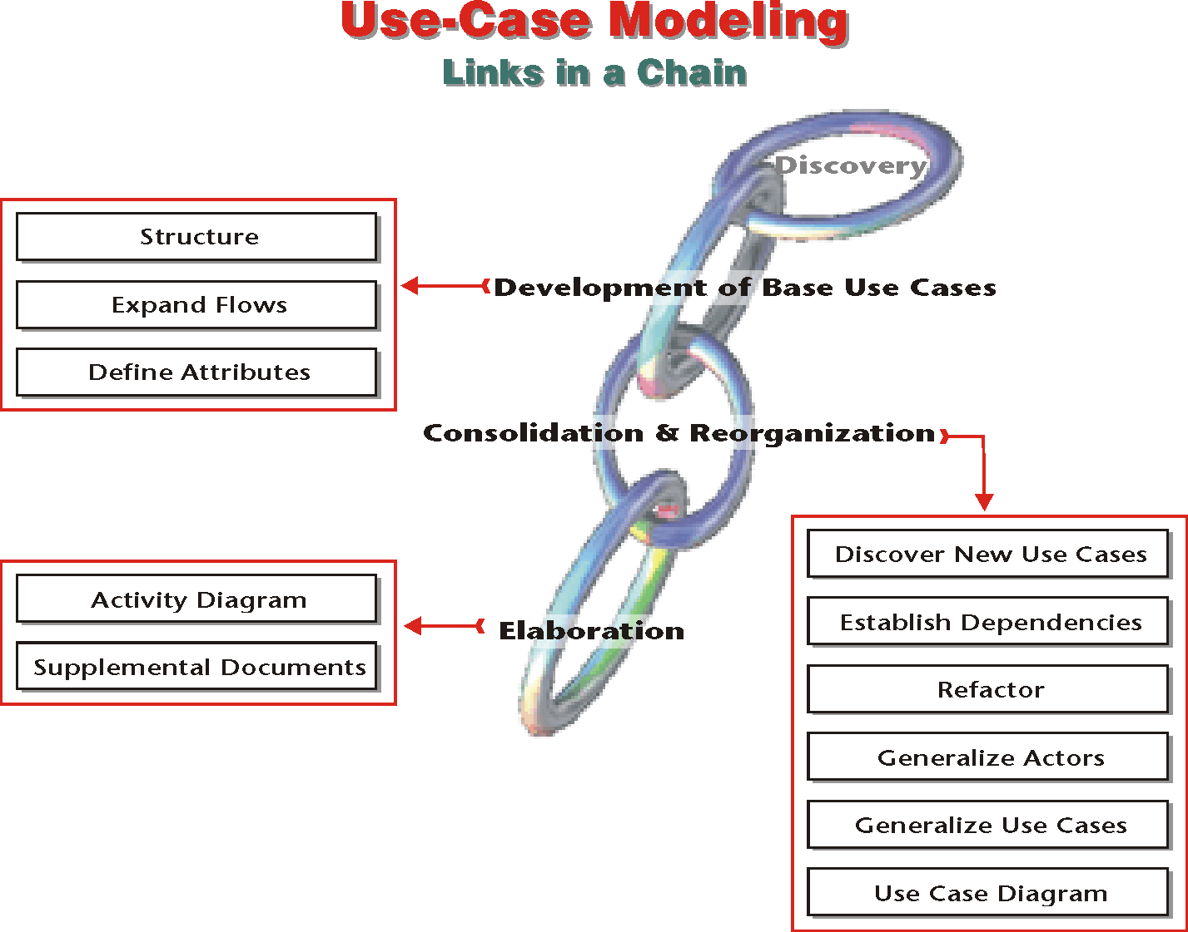
A Framework for the Development

Slide 4
Develop Base Use Cases
What a “base” use case is?
A base use case is a fully formed, structured use case which serves as a base to develop other analysis and design artifacts.

Slide 5
The Template
The template structures use cases by providing well-defined and ordered fields.

Slide 6
Template Fields
Template fields represent the building blocks of the use cases, joined in a predefined, orderly manner.

Slide 7
Template Fields
Name
embodies the goal that the use case wants to accomplish.
ID
is unique numeric identifier for the use case.
Scope
boundaries of the use case— defined by the system or the subsystem to which it belongs.
Priority
decides the order of design and implementation for use cases.

Slide 8
Template Fields
Summary
a long version of the use case name and a short version of the scenario.
Primary actor
is the actor whose goal identifies and drives the use case.
Supporting actor
assist the primary actor in achieving the goal of the use case.

Slide 9
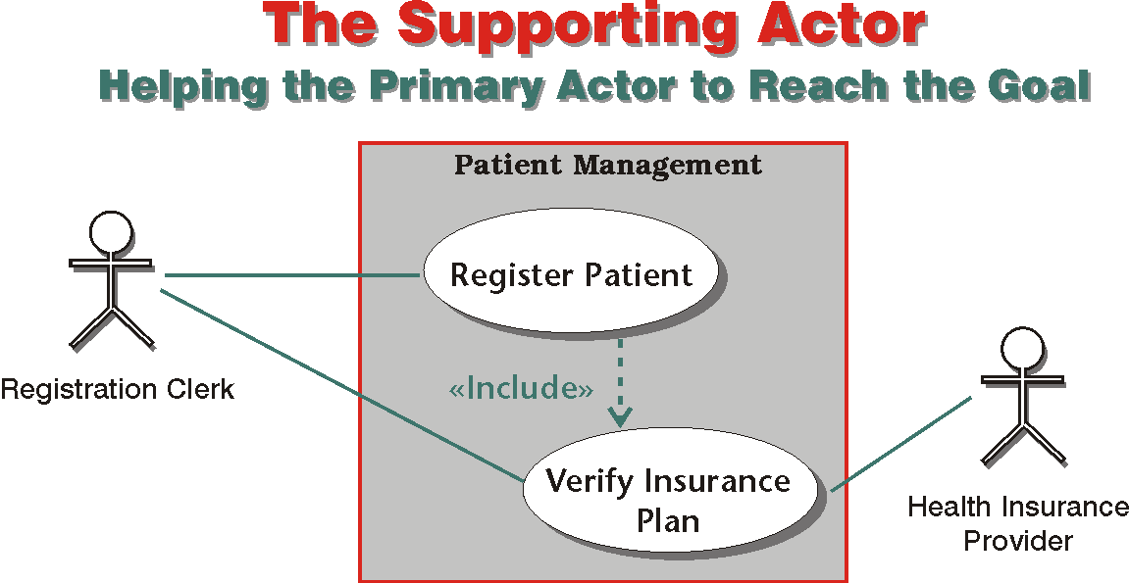

Slide 10
Template Fields
Stakeholder
any entity, human or otherwise, who has an interest in the outcome of the use case.
Precondition
defines the state of the system before a use case can start; post-condition defines the state of the system after a use case is complete.
Trigger
the event that starts the use.
A flow
an ordered set of activities that occur as the actors and the system attempt to reach a goal.

Slide 11
Normal Flow
Normal flow is the best-case scenario
Conduct ATM Transaction | Normal Flow: | 1. Customer inserts the bank card. 2. Customers enters password. 3. System verifies password. 4. System presents a list of transaction types that the customer may conduct. 5. Customer selects a type of transaction.

Slide 12
Sub-Flows
Sub-flows identify the details of the steps in the normal flow
Register Patient | Normal Flow: | 1. The registration clerk enters or updates personal data.
 | Sub Flows: | 1.1 The registration clerk enters the Social Security Number of the new patient. 1.2 The registration clerk enters or updates patient’s address. 1.3 The registration clerk enters or updates patient’s phone number. 1.4 The registration clerk enters or updates the name, the address and the phone number of the patient’s closest relative.

Slide 13
Alternate Flow and Exceptions
Alternate steps identify remedies; exceptions signify failure
Receive Patient | Alternate Flow/ Exceptions: | 3.a Patient is new. Reception clerk directs the patient to registration… 3.bPatient is not new but personal or insurance data has changed. Reception clerk directs the patient to registration… 3.cPatient has lost the hospital ID card. Reception clerk directs the patient to registration…

Slide 14
Non-Behavioral Requirements
Only when a non-behavioral requirements applies to a specific use case, the requirement is specified in the template.

Slide 15
Template Fields
Open Issues
questions that must be resolved before the use case can be judged as complete.
Audit fields
help us to keep track of the evolution of the use case.
Custom Fields
specifies an attribute or requirement that is specific to one use case or a set of use cases within the system.

Slide 16
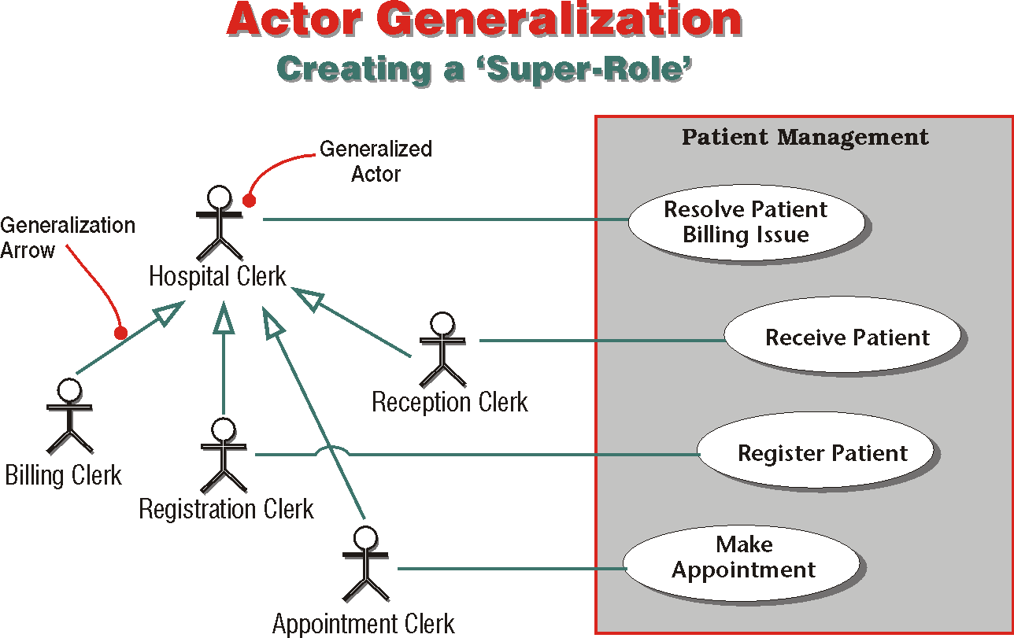

Slide 17
Actor Dictionary
Actor | Description | Abstract | Use Case (s)
Appointment Clerk | Makes appointment for the patient to receive medical service. |  | Make Appointment
Billing Clerk | Maintains patient billing. |  | Enter Bulk Payment
Hospital Clerk | Generalizes: Appointment Clerk Billing Clerk Reception Clerk Registration Clerk | ✓ | Resolve Patient Billing Issue
Reception Clerk | Receives patient on arrival at the hospital. Verifies registration. Arranges for the patient to receive medical service. |  | Receive Patient
Registration Clerk | Enters or updates patient’s personal and payment data. Issues a hospital card, if necessary. |  | Register Patient

Slide 18
Dependencies: Include and Extend
An extend relationship is one in which a use case is created to extend the functionality of a base use case.
Register Patient | Alternate Flow/ Exceptions: | 2.a The patient is not new and insurance data has not changed. Registration clerk does not update the insurance data by default. 2.b The patient wants to pay the entire bill or the co-payments by a credit card. Registration clerk verifies the credit card (Extend: 142 - Verify Credit Card) and records credit card information.

Slide 19
Include Relationship
An include relationship is one in which one use case uses the functionality of another, independent, use case.
Receive Patient | Normal Flow: | … 3. Reception clerk verifies that patient has been registered and registration is valid. …
 | Alternate Flow/ Exceptions: | 3.a Patient is new. Reception clerk directs the patient to registration. (Include: 140 - Register Patient.) …

Slide 20
Use Case Diagram for Dependencies
In a use case diagram, dependency type is indicated by the direction of an arrow.

Slide 21
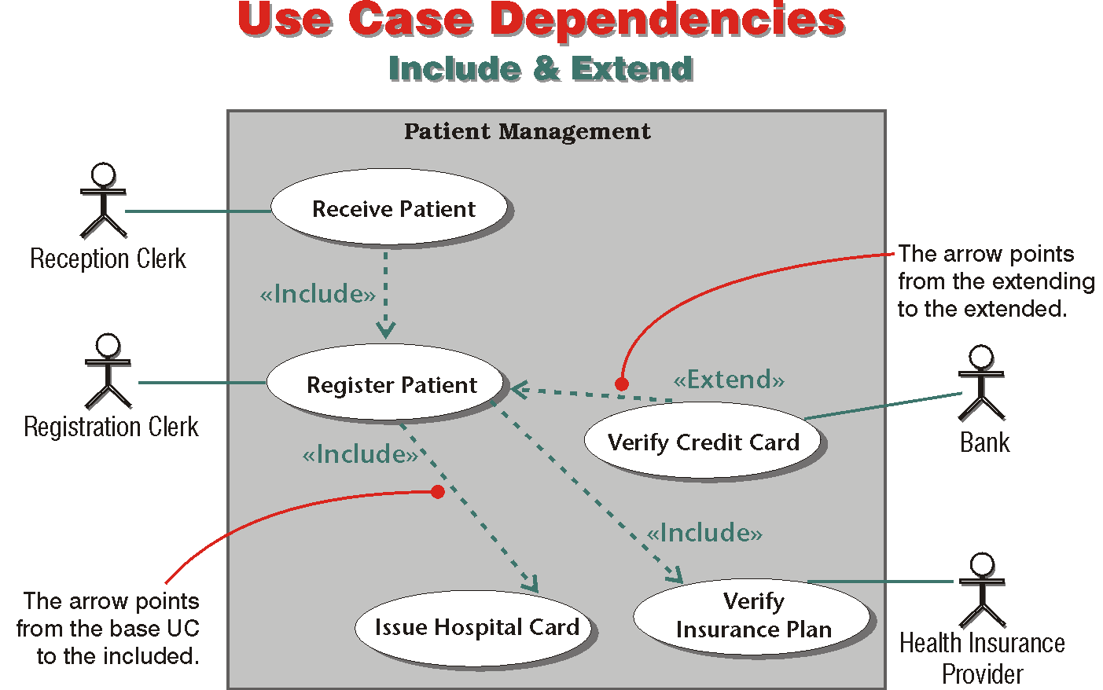

Slide 22
Base UC | Arrow’s Direction | Referenced UC
Extended UC Register Patient | ← | Extending UC Verify Credit Card
Including UC Receive Patient | → | Included UC Register Patient

Slide 23
Use Case Generalization
We generalize use cases when the they achieve the same goal by different means.

Slide 24
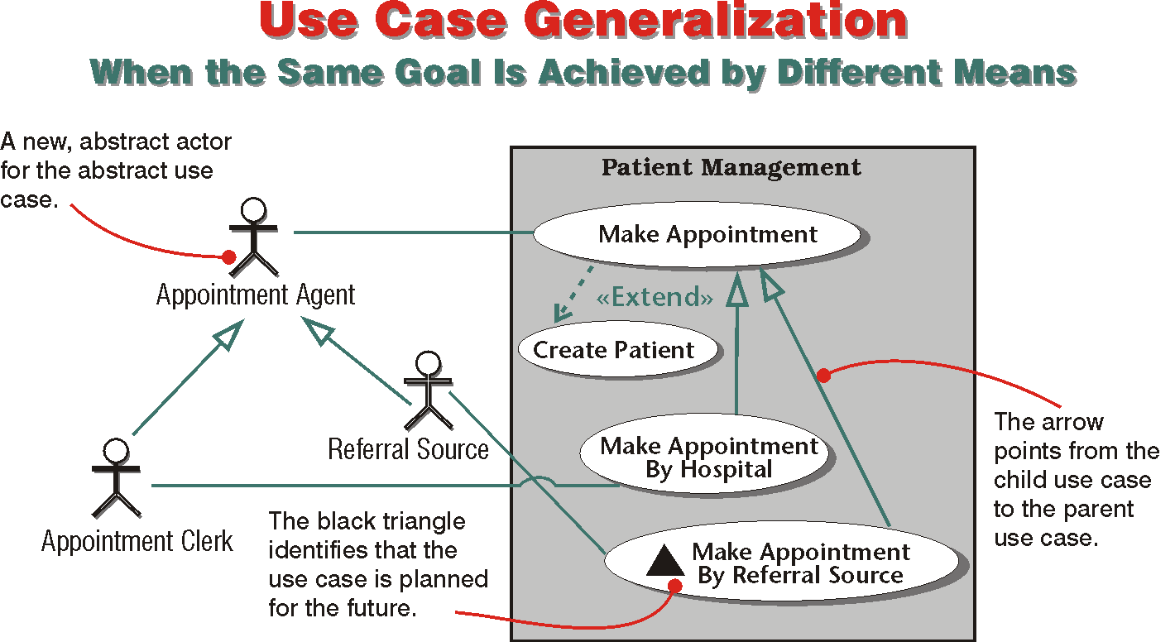

Slide 25
Use Case Diagram
Use case diagram is a meta-model that portrays associations among actors, use cases and the system.

Slide 26
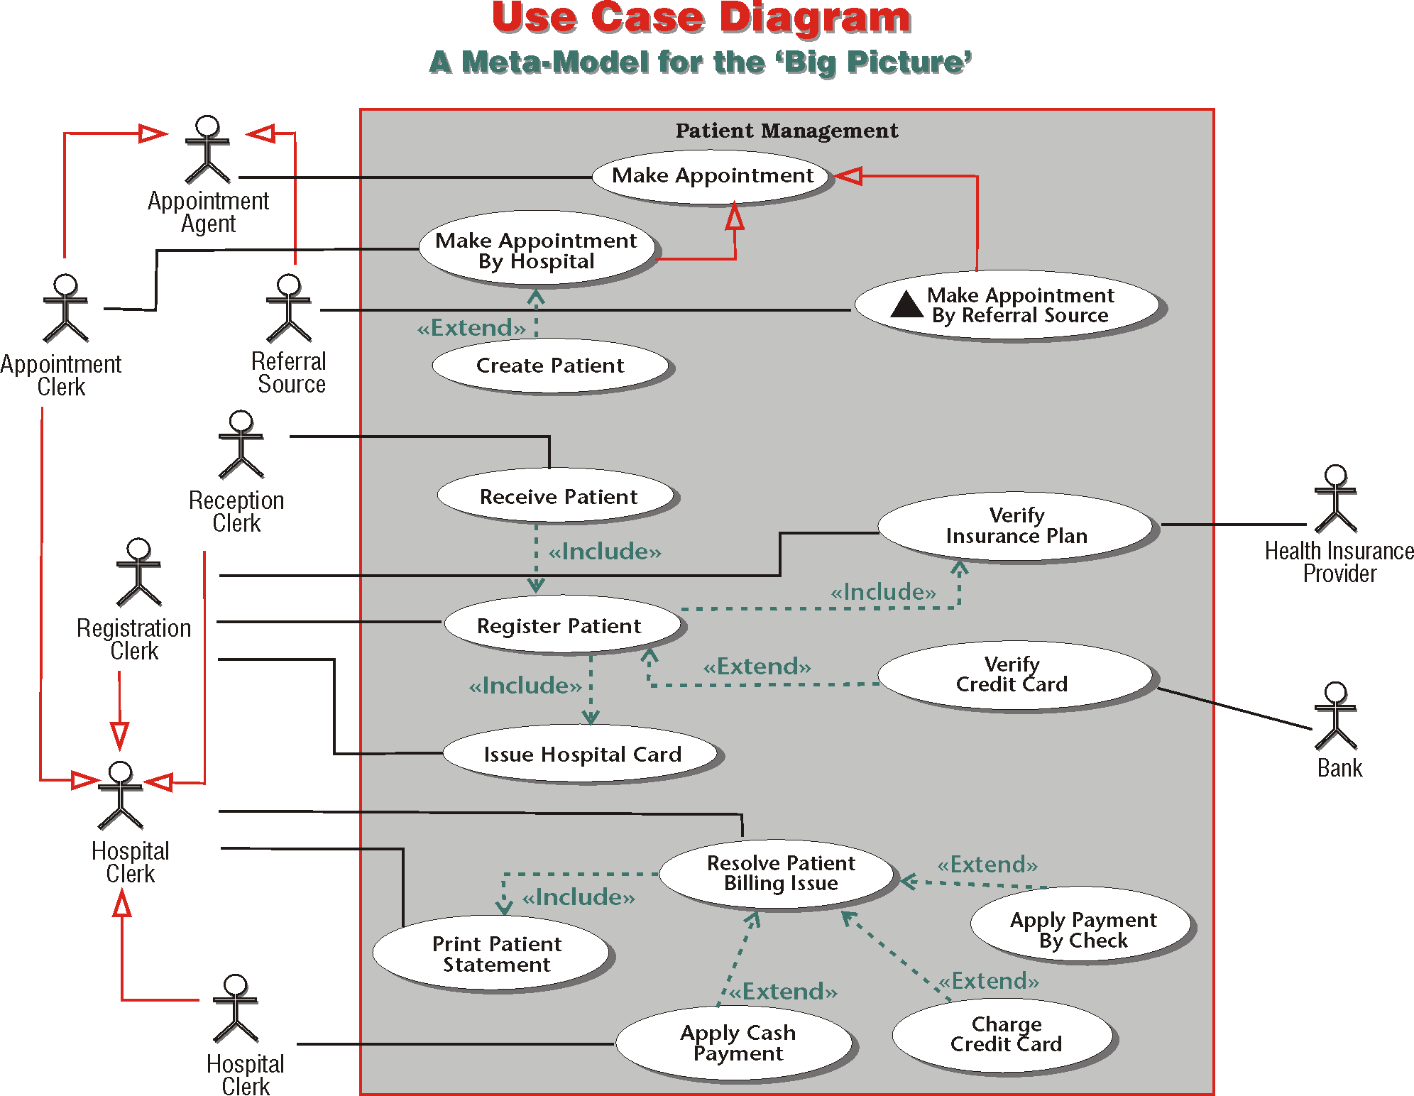

Slide 27
Separating and Joining Use Cases
❶ We delineate them.
❷ We divide them into more use cases.
❸ We combine them.

Slide 28
Delineating Use Cases
One use case must have one primary actor, one useful goal and one system.

Slide 29
Dividing Use Cases
New requirements or the challenge of complexity may demand that a use case be divided:
Vertical division is necessary if the use case has too many parallel steps.
Horizontal division is necessary if the flow is too complex or the building blocks of the use case lack unity.

Slide 30
Refactoring
Refactoring abstracts and reorganizes common behavior among use cases into new use cases.

Slide 31
Activity Diagram
Activity diagram depicts the flow from activity to activity. It presents a visual, dynamic view of the system and its components.

Slide 32
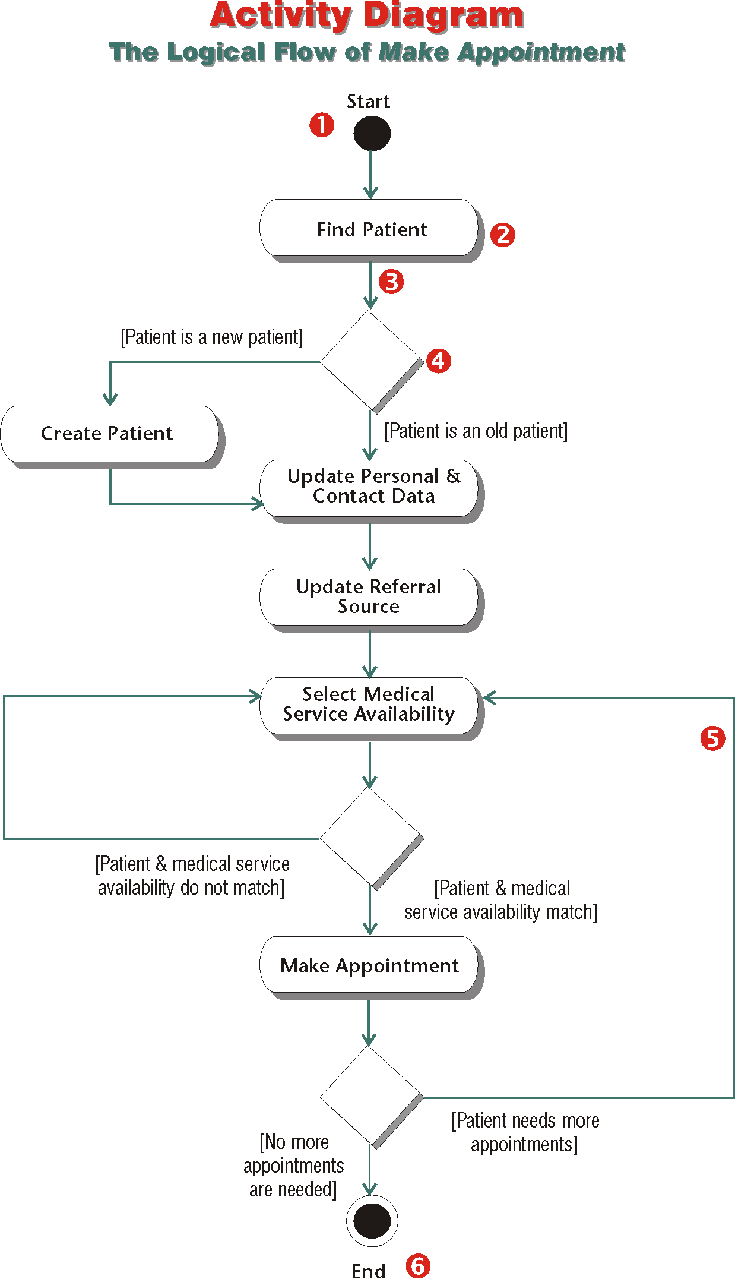

Slide 33
Uses of Use Cases
Use cases provide a crucial framework for analysis, design, implementation and deployment activities.

Slide 34
Uses of Use Cases
Requirements Gathering
Use cases provide the base tools for gathering requirements within a meaningful context.
Requirements Traceability
Use cases and their supporting documents are the prime sources for tracing requirements.
Business Rules
Use cases are the framework for gathering business rules.
System Behavior
The external behavior of any open system can be captured effectively through use cases.

Slide 35
Uses of Use Cases
Object Derivation
By launching a cycle of gathering requirements from the use cases, we can arrive at many of the objects that would form the structure of the system.
Incremental Development
By prioritizing use cases and their dependencies, we can build a system incrementally.
Base for User Interface
Use cases describe the basics messages that the actor and the system must exchange to achieve a goal.
Test Case Definition
Use cases are the conceptual blueprints for functional test cases.
Base for User Documentation
Use cases are built to describe the interaction between a user type and a system.
Business Process Modeling
Use cases can be used to model business processes, prior to, after, or independent from an information system.

Slide 36
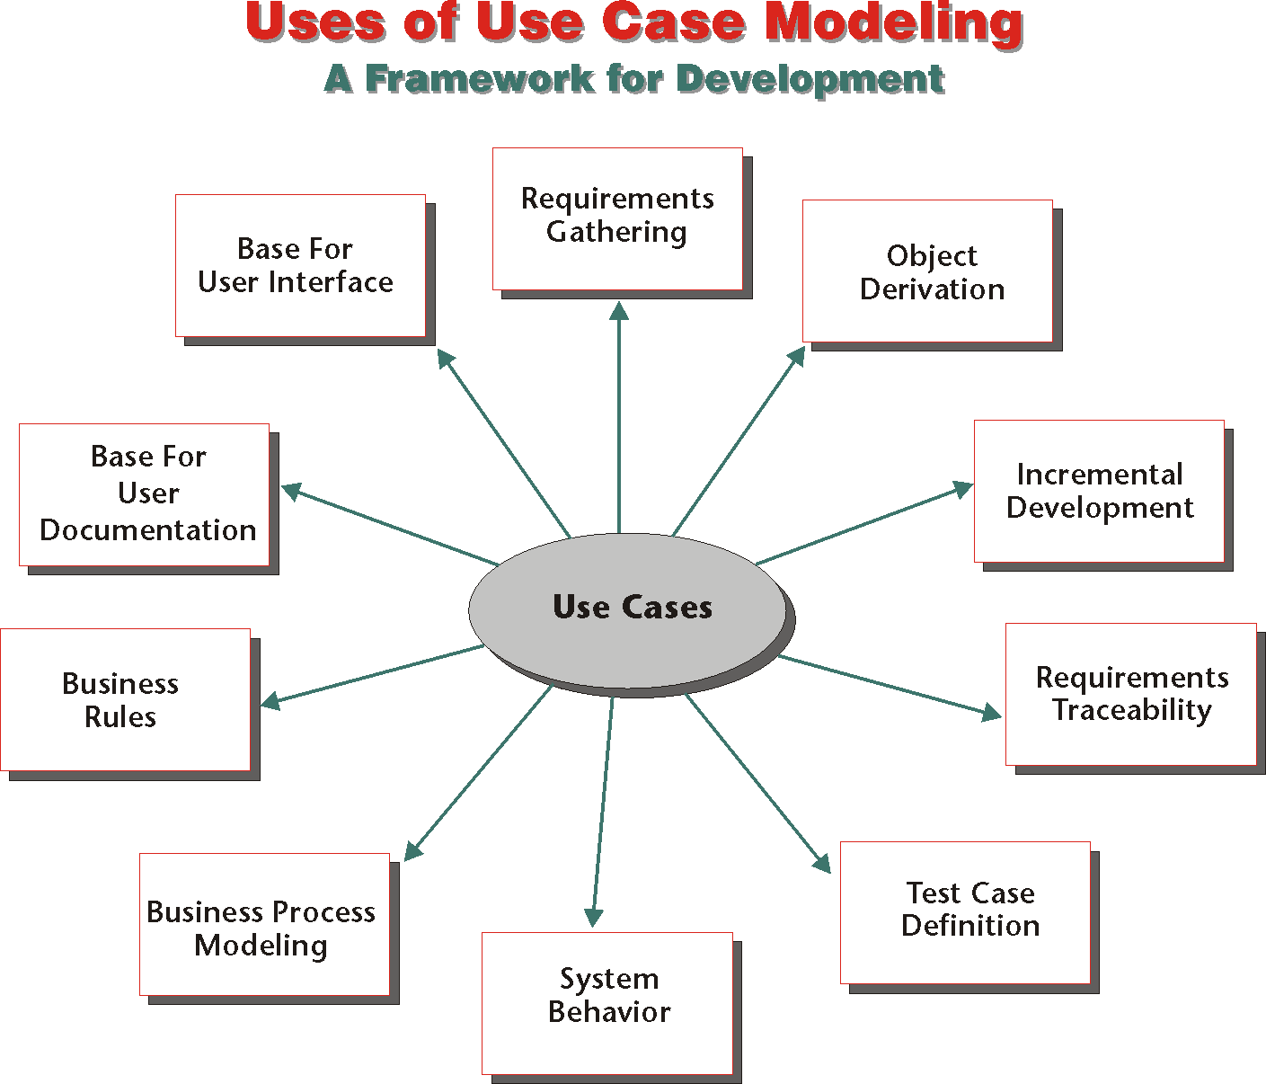

Slide 37
Next: Structural Modeling
The basic building blocks of an information systems are objects.
An object is created from a mold called class.
To make objects we have to make classes, and this is the starting point of the next chapter.

